Slide 1
Welcome!
Sunday
Bible Study 9:30 AM
Worship 10:30 AM
Wednesday
Bible Class 7:00 PM
www.SunsetchurchofChrist.net

Slide 2
John 8:21-30
Jesus reveals His goal
Belief in Jesus
Speaking from the Father

Slide 3
Welcome!
Sunday
Bible Study 9:30 AM
Worship 10:30 AM
Wednesday
Bible Class 7:00 PM
www.SunsetchurchofChrist.net

Slide 4
Opening Prayer
Song –
Scripture Reading
Song –
Song –
Lord’s Supper
Song –
Collection
Song –
Lesson | Brian Haines
Song –
Closing

Slide 5
A Good God
Vs.
A Horrible Hell

Slide 6
Good Versus Evil
Good and evil are defined two ways
By internal reasoning
Most common definition
Serious flaws are obvious
By a concrete external

Slide 7
Good Versus Evil
Good and evil are defined two ways
By internal reasoning
By a concrete external
Need to agree on a common source
Nature? Not very good…..
God – a greater power and mind

Slide 8
God is Good
"No one is good but One, that is, God” Luke 18:19
His purposes are good – Genesis 1:4-31
His rules are good – Deuteronomy 6:24
Notes:
Seven times in Genesis 1 God calls the creation good
Ge 1:4 And God saw the light, that it was good; and God divided the light from the darkness.
Ps 33:5 He loves righteousness and justice; The earth is full of the goodness of the LORD.
De 6:24 'And the LORD commanded us to observe all these statutes, to fear the LORD our God, for our good always, that He might preserve us alive, as it is this day.

Slide 9
The Terror of Hell
And anyone not found written in the Book of Life was cast into the lake of fire. Revelation 20:15
the smoke of their torment ascends forever and ever; and they have no rest day or night, Revelation 14:11
Notes:
Seven times in Genesis 1 God calls the creation good
Ge 1:4 And God saw the light, that it was good; and God divided the light from the darkness.
De 6:24 'And the LORD commanded us to observe all these statutes, to fear the LORD our God, for our good always, that He might preserve us alive, as it is this day.

Slide 10
How do we reconcile…..
God is good
He loves us
He wants us to be with Him
Hell is terrible
God (will) cast men there
How are both of these things true?

Slide 11
God and Hell
What is Hell?
Eternal torment – Matthew 25:46
Flame – Luke 16:24
Darkness – Jude 6
A place not yet populated – Jude 16
Notes:
Mt 25:46 "And these will go away into everlasting punishment,
Lu 16:24 And he cried and said, Father Abraham, have mercy on me, and send Lazarus, that he may dip the tip of his finger in water, and cool my tongue; for I am tormented in this flame.
Jude 1:13 Raging waves of the sea, foaming out their own shame; wandering stars, to whom is reserved the blackness of darkness for ever.

Slide 12
God and Hell
What is Hell?
Eternal torment
Being “cast out” from God’s presence
Mark 9, Matthew 25, etc.

Slide 13
God and Hell
What is Hell?
Eternal torment
Being “cast out” from God’s presence
Hell is the absence of God’s goodness

Slide 14
God and Hell
Why hell?
God cannot permit sin in His presence
Psalm 68:2, Isaiah 6:5, Hab. 1:13
Notes:
Ps 68:2 As smoke is driven away, So drive them away; As wax melts before the fire, So let the wicked perish at the presence of God.
Isa 6:5 ¶ So I said: "Woe is me, for I am undone! Because I am a man of unclean lips, And I dwell in the midst of a people of unclean lips; For my eyes have seen the King, The LORD of hosts.“
Hab 1:13 You are of purer eyes than to behold evil, And cannot look on wickedness. Why do You look on those who deal treacherously, And hold Your tongue when the wicked devours A person more rightous than he?

Slide 15
God and Hell
Why hell?
God cannot permit sin in His presence
God’s nature is also just and true
Psalm 89:14, 99:4
Notes:
Ps 89:14 Righteousness and justice are the foundation of Your throne;
Ps 99:4 The King's strength also loves justice; You have established equity; You have executed justice and righteousness in Jacob.

Slide 16
God and Hell
Why hell?
God cannot permit sin in His presence
God’s nature is also just and true
Man is an eternal being
Ecclesiastes 3:11, Genesis 1:26
Notes:
Ec 3:11 ¶ He has made everything beautiful in its time. Also He has put eternity in their hearts, except that no one can find out the work that God does from beginning to end.
Ge 1:26 ¶ Then God said, "Let Us make man in Our image,

Slide 17
God and Hell
Hell is an inevitable necessity
Hell exists not because God created a place to torment His enemies, but because those who would not go with God must remain apart from all of His goodness

Slide 18
Why God is Good
God cannot tolerate this situation
How could He change it?
Not create us?
God desires “Godly offspring”
Love Him with all our might
Notes:
Mal 2:15 But did He not make them one, Having a remnant of the Spirit? And why one? He seeks godly offspring. Therefore take heed to your spirit, And let none deal treacherously with the wife of his youth.

Slide 19
Why God is Good
God cannot tolerate this situation
How could He change it?
Not create us?
Not permit us free will?
Is our love actually love?

Slide 20
Why God is Good
God cannot tolerate this situation
How could He change it?
Answer: a plan of salvation we must choose

Slide 21
Why God is Good
1) God Himself would pay the cost
“Purchased with His own blood” Acts 20:28
“Author and finisher” Hebrews 12:2

Slide 22
Why God is Good
1) God Himself would pay the cost
2) God Himself would reveal it to us
“they shall all be taught by God” John 6:45
“the word…is living and active” Hebrews 4:12

Slide 23
Why God is Good
1) God Himself would pay the cost
2) God Himself would reveal it to us
3) God makes sure everyone gets a chance
“desires all men to be saved” 1 Timothy 2:4

Slide 24
Reconciling Ideas
God has done all He can to save us
He has paid the cost of our sins
He has revealed to all salvation
He has made sure everyone is included
His plan is easy
Notes:
Heb 2:4 God also bearing witness both with signs and wonders, with various miracles, and gifts of the Holy Spirit, according to His own will?

Slide 25
Reconciling Ideas
God has done all He can to save us
There are things God cannot do
Be unjust and ignore sin
Remove our free-will
Notes:
Heb 2:4 God also bearing witness both with signs and wonders, with various miracles, and gifts of the Holy Spirit, according to His own will?

Slide 26
Reconciling Ideas
God has done all He can to save us
There are things God cannot do
God’s other option: destroy us all
Notes:
Heb 2:4 God also bearing witness both with signs and wonders, with various miracles, and gifts of the Holy Spirit, according to His own will?

Slide 27
Conclusions
A Good God does not “send” us to Hell
He does all He can to change that
We make the choice as to whether we make it
He cannot be faulted for our choices
Notes:
Heb 2:4 God also bearing witness both with signs and wonders, with various miracles, and gifts of the Holy Spirit, according to His own will?

Slide 29
Where Are You Going
Heaven and Hell are up to you
You choose to believe what you heard
You choose to confess that belief
You choose to repent
You choose to be baptized
You choose to remain faithful

Slide 30
Sunset Church of Christ
Financial report May 2022

Slide 31
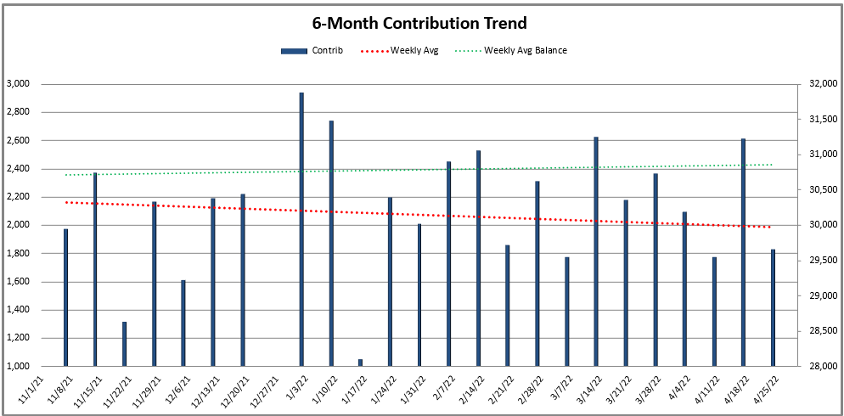
Last 3 month avg contribution ~$2,196/wk
2021 avg contribution ~$2,098/wk
Last 3 month avg balance ~$30,964
2021 avg balance ~$33,738

Slide 32
Apr-2022 Itemized
Beginning Balance (April 1, 2022) |  |  | $ 31,015.83
Deposits |  | $ 8,306.10 | $ 39,321.93
Expenses | $ (8,388.60)
Rent | $ (3,669.40)
Brian Haines | $ (4,622.00)
Other (Electric, Water, Garbage/Recycling, Building) | $ (97.20)
Ending Balance (April 30, 2022) |  |  | $ 30,933.33

Slide 33
Mar-2022 Itemized
Beginning Balance (March 1, 2022) |  |  | $ 30,553.15
Deposits |  | $ 8,939.35 | $ 39,492.50
Expenses | $ (8,476.67)
Rent | $ (3,669.40)
Brian Haines | $ (4,622.00)
Other (Electric, Water, Garbage/Recycling, Building) | $ (185.27)
Ending Balance (March 31, 2022) |  |  | $ 31,015.83

Slide 34
Feb-2022 Itemized
Beginning Balance (February 1, 2022) |  |  | $ 27,799.42
Deposits |  | $ 11,158.99 | $ 38,958.41
Expenses | $ (8,405.26)
Rent | $ (3,669.40)
Brian Haines | $ (4,622.00)
Other (Electric, Water, Garbage/Recycling, Building) | $ (113.86)
Ending Balance (February 28, 2022) |  |  | $ 30,553.15

Slide 35
Backup

Slide 36
Meeting location
Current rent to 5/31/2022: $3,394 + $275.40 (NNN) = $3,669.40
3,060 sq ft $1.20/sq ft/month $14.34/sq ft/year
Auditorium seating ~100 attendees
4 classrooms, restrooms (mens and womens) and ample parking
Response options current landlord:
Month-to-month rental from landlord – estimated ~$100/month or 3% annual increase – request 60 day notice to vacate and property left “as is”
Renew current lease for 36 months – estimated $100/month or 3% annual increases same as previous

Slide 37
Jan-2022 Itemized
Beginning Balance (January 1, 2022) |  |  | $ 27,747.91
Deposits |  | $ 8,918.53 | $ 36,666.44
Expenses | $ (8,867.02)
Rent | $ (3,669.40)
Brian Haines | $ (4,922.00)
Other (Electric, Water, Garbage/Recycling, Building) | $ (275.62)
Ending Balance (January 31, 2022) |  |  | $ 27,799.42

Slide 38
Dec-2021 Itemized
Beginning Balance (December 1, 2021) |  |  | $ 30,442.38
Deposits |  | $ 6,022.00 | $ 36,464.38
Expenses | $ (8,716.47)
Rent | $ (3,669.40)
Brian Haines | $ (4,922.00)
Other (Electric, Water, Garbage/Recycling, Building) | $ (125.07)
Ending Balance (December 30, 2021) |  |  | $ 27,747.91

Slide 39
Nov-2021 Itemized
Beginning Balance (November 1, 2021) |  |  | $ 29,340.18
Deposits |  | $ 9,802.40 | $ 39,142.58
Expenses | $ (8,700.20)
Rent | $ (3,669.40)
Brian Haines | $ (4,922.00)
Other (Electric, Water, Garbage/Recycling, Building) | $ (108.80)
Ending Balance (November 30, 2021) |  |  | $ 30,442.38

